Slide 1
CS440/520
Artificial Intelligence
Computer Science Department
Lecture 2:
Uninformed Search
4 September 2014
Instructor: Kostas Bekris

Slide 2
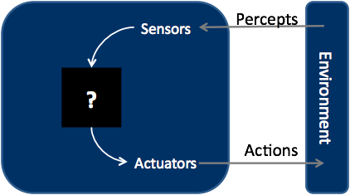
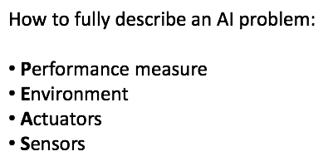
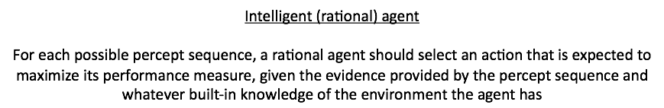
Intelligent Agents

Slide 3
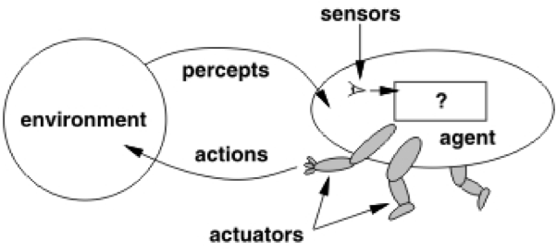
How do agents work?

Slide 4
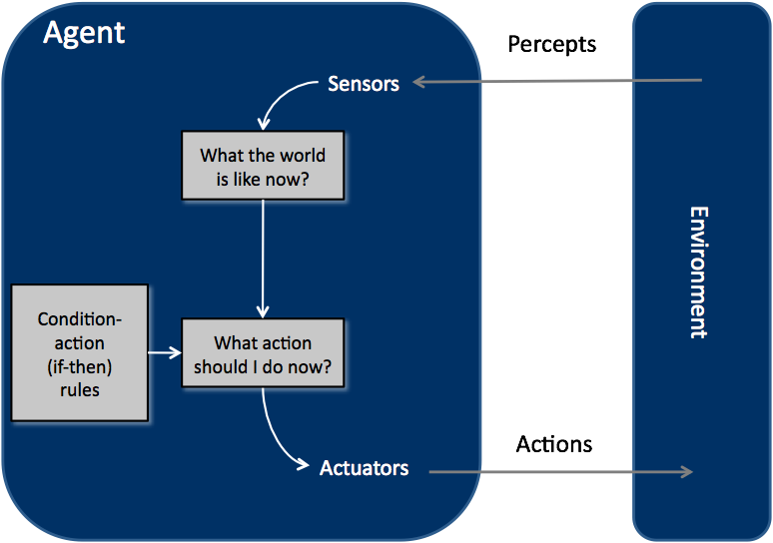
Reflex Agents

Slide 5
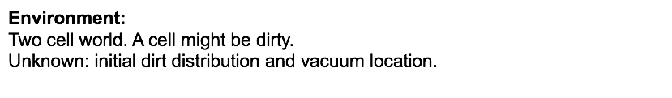
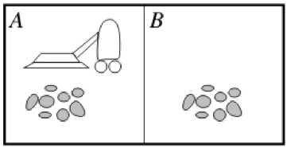
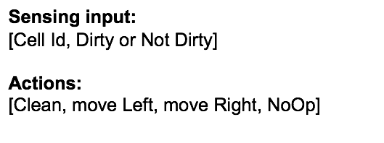

Vacuum World

Slide 6
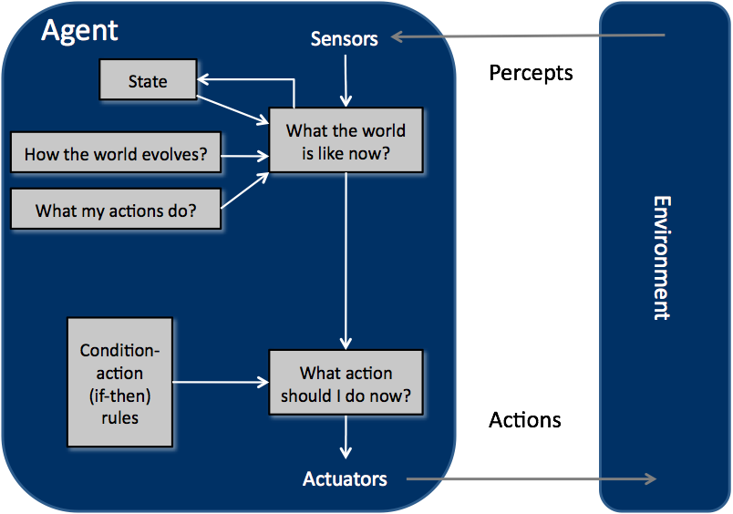
Model-based Reflex Agents

Slide 7
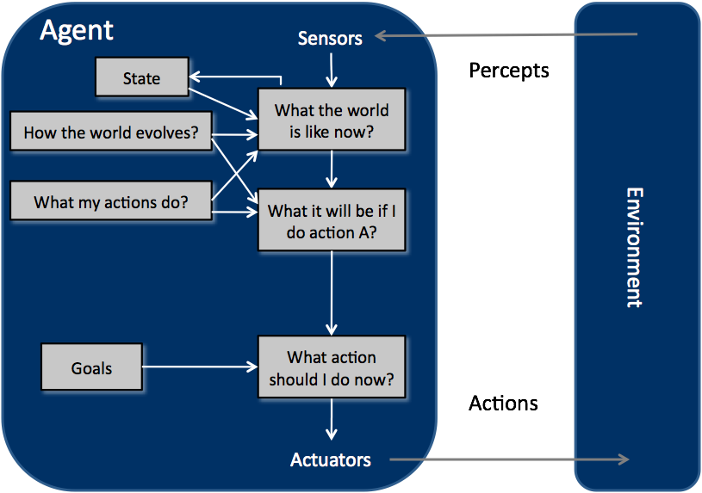
Goal-based Agents

Slide 8
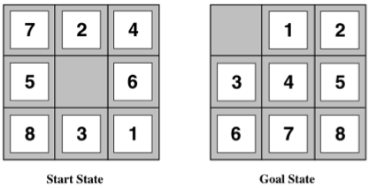
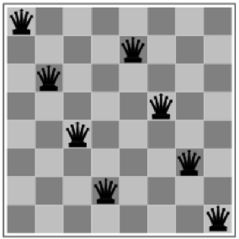
Problem Examples
8-puzzle problem
Search Problems
(i.e., problems for goal-based agents)
Need to define:
a state space X
a successor function X x U→X
an initial and goal state
and a performance measure
8-queens problem

Slide 9
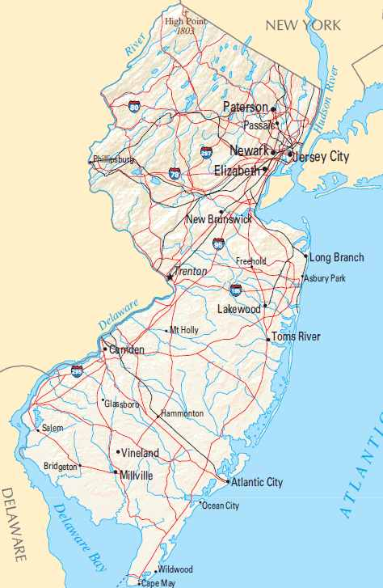
Path finding problems
Path finding:
The prototypical
goal-based
problem
Abstraction:
Graph-based
path
finding

Slide 10
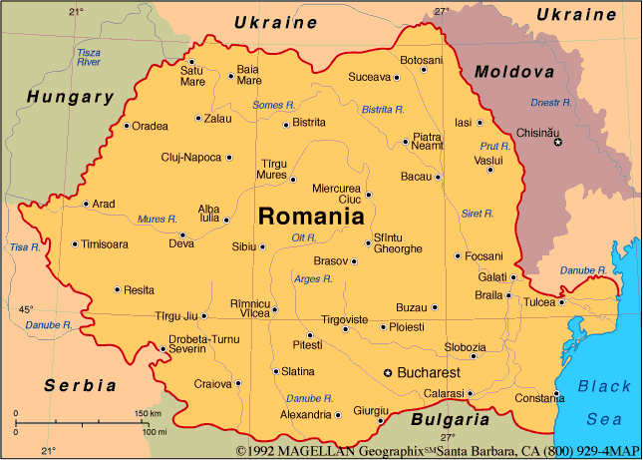
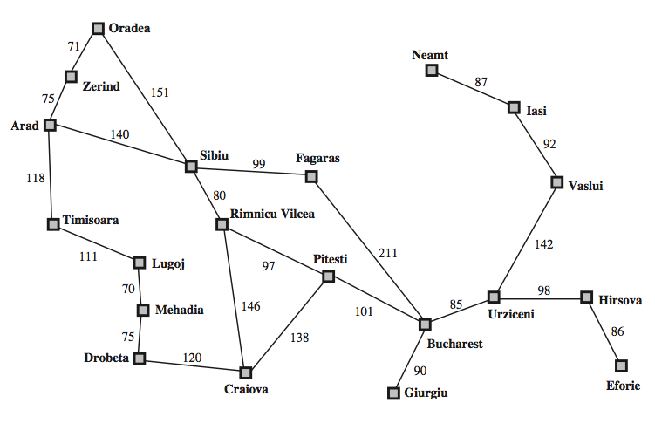
Search Example

Slide 11
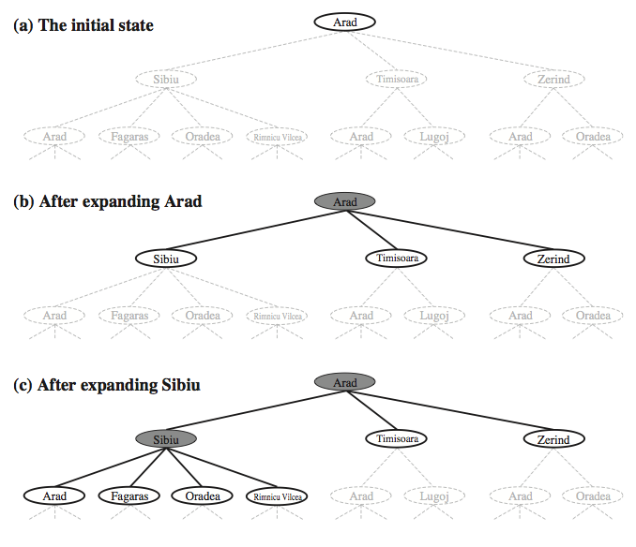
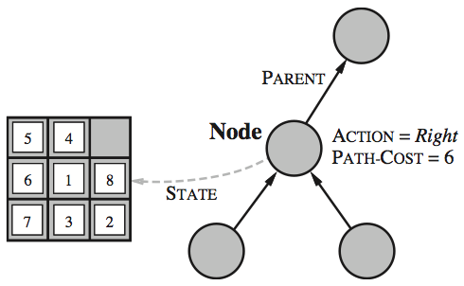
Search Tree

Slide 12
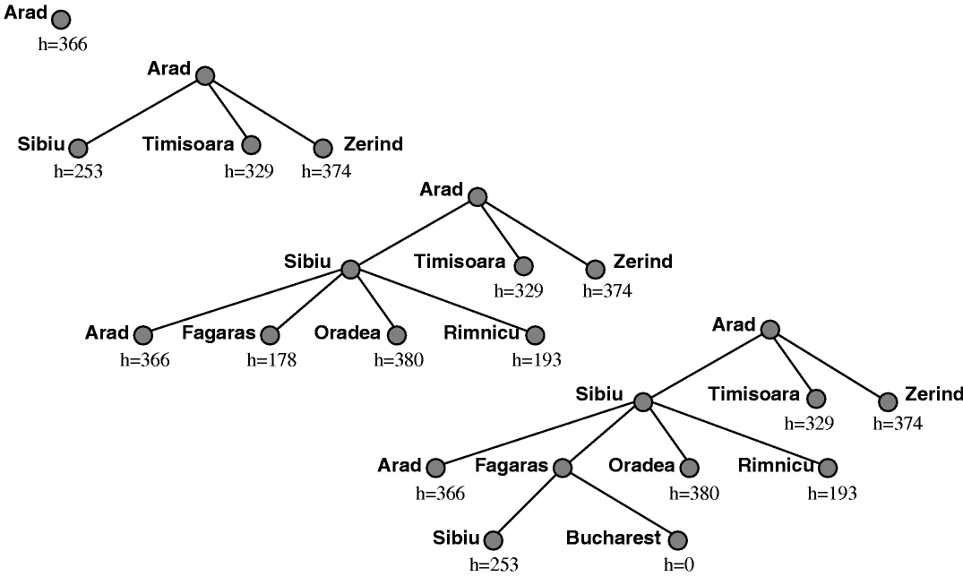
Fringe

Slide 13
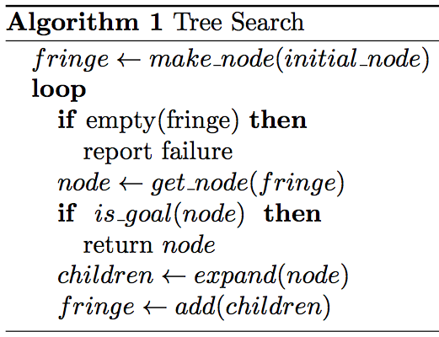
Tree Search

Slide 14
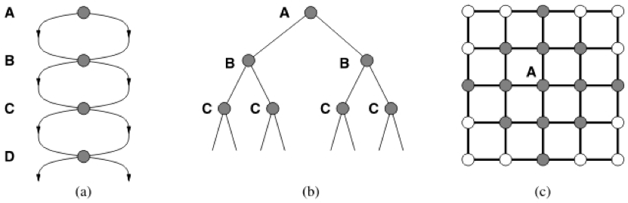
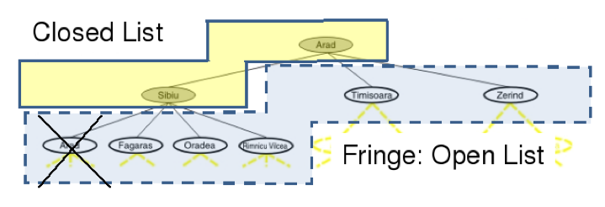
Avoiding Repeated States

Slide 15
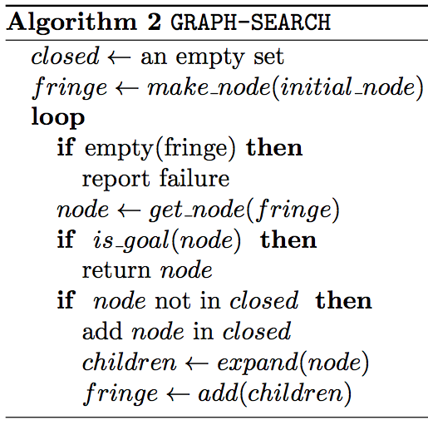
Graph Search
Key operation: get_node(fringe)
Different implementations give rise to different properties

Slide 16
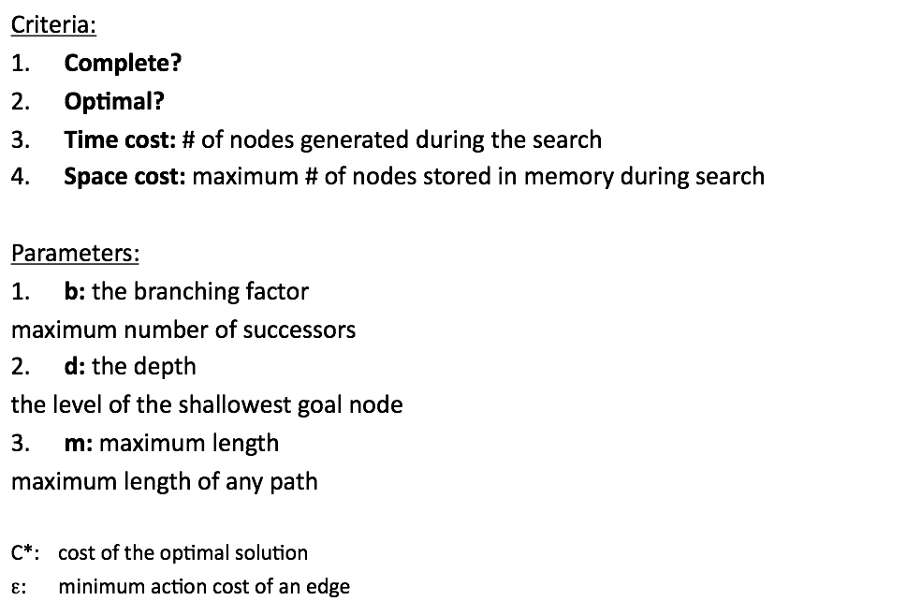
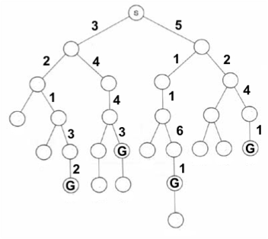

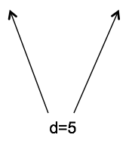


Comparing Search Strategies

Slide 17
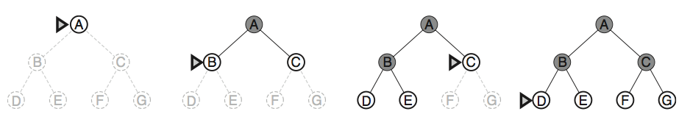
Breadth-first Search
Fringe stored as FIFO queue

Slide 18
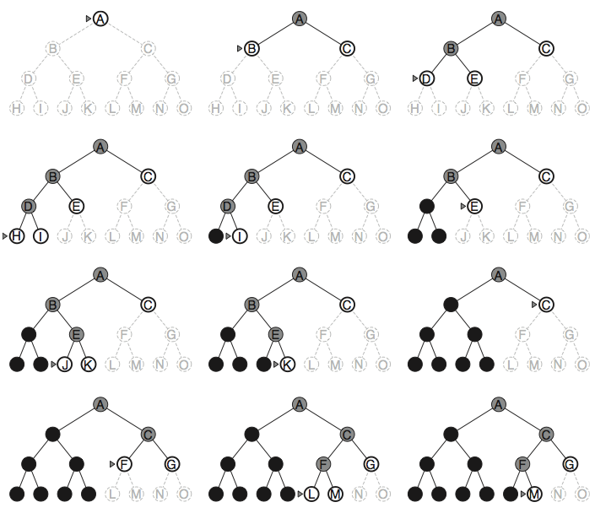
Depth-first Search
Fringe stored as
LIFO stack

Slide 19
Can we achieve optimality?

Slide 20
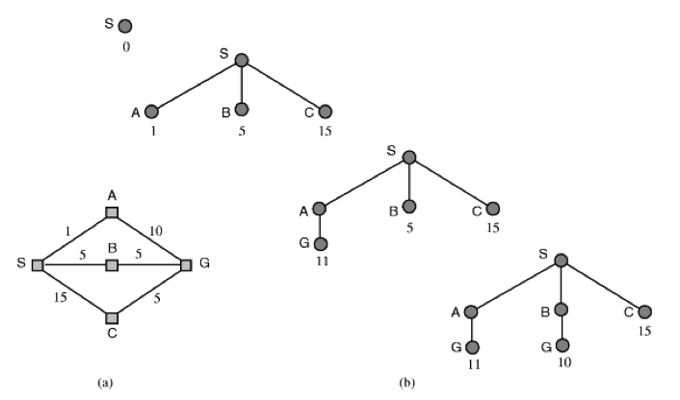
Uniform-cost Search
Fringe stored as
a priority queue
where priorities are defined based on the
minimum
“g: cost-from-start”

Slide 21
Can we have a good trade-off
between
completeness/optimality
and
space requirements?
We need a tradeoff between
completeness/optimality
and
space requirements
We need a tradeoff between
completeness/optimality
and
space requirements
We need a tradeoff between
completeness/optimality
and
space requirements
We need a tradeoff between
completeness/optimality
and
space requirements
We need a tradeoff between
completeness/optimality
and
space requirements

Slide 22
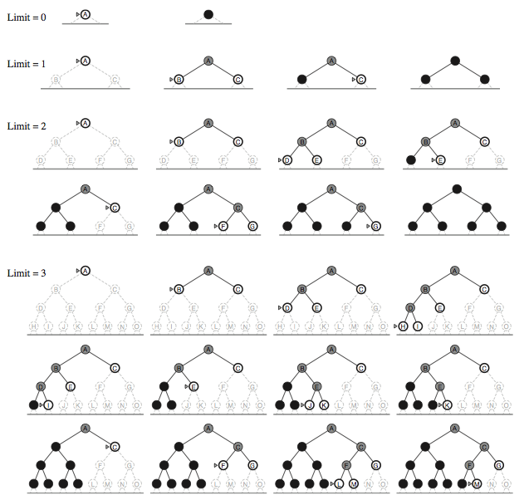
Iterative-Deepening Search

Slide 23
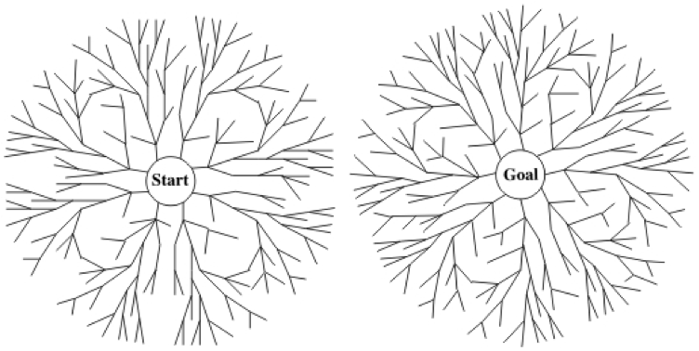
Bidirectional Search

